Slide 1
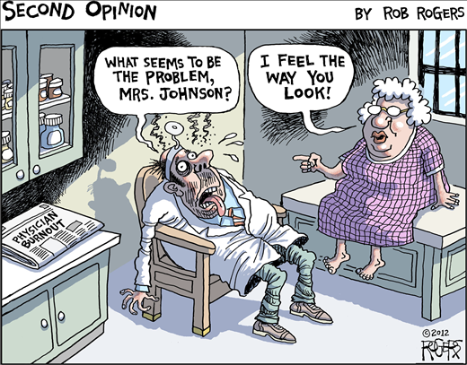

Slide 2
Sabina Abidi Christine Dipchand Andrew Lynk Tanya Munroe Amy Ornstein Tobias Witter
DNS LEADERSHIP COURSE
April 27, 2018
Physician Burnout:
Healthy Physicians Lead to
Better Care & Healthy Communities

Slide 3
Notes:
Throughout this presentation there will be exemplar direct quotes from our project research

Slide 4
“..it is difficult not to continue to lose hope and consider leaving the province or profession.”

Slide 5
Notes:
Burnout is characterized by feelings of exhaustion, cynicism and inefficiency when referring to work and the work environment.
In a recent DNS survey of Nova Scotia physicians (2017)
workload was a factor
disengagement with the system
feeling ineffective

Slide 6
“I would like not to take work home to do after my kids are in bed”

Slide 7
Our Purpose
Identify, recommend, and advocate for actionable strategies to address burnout in physicians in our province.

Slide 8
“I have no idea what I can change. I’m simply trying to keep my head above water.”

Slide 9
Mitigation Survey: Methods
Literature review completed
Input from stakeholders & DNS researchers
Beta-tested with stakeholders
Disseminated to members by DNS (Feb 18)
Notes:
Literature review to identify strategies shown to mitigate burnout and a survey tool was created
Input was sought from primary stakeholders and researchers of initial Doctors NS survey
Beta-tested with stakeholders to finalize a mitigation survey
content experts, GP Council, additional experts in field
Disseminated to members by Doctors NS (February 2018)

Slide 10
“I feel unsupported implementing system changes when using all my energy to survive.”

Slide 11
Qualitative Survey: Methods
These standardized questions were administered to a targeted audience
What are 2 things that could change about my work environment or the work that I do that would allow me to feel less exhausted, cynical or ineffective?
How would you like to see these 2 items implemented?
What are 2 things about your work environment or work that currently energize and help you feel less cynical and more effective?
Notes:
We used these two questions as beta testing and to enrich our data about this topic, these were also used on the quantitative survey that was sent out by DNS

Slide 12
Our Quantitative Results
Response rate of 14% of Nova Scotia’s 2500 physicians.
85% of respondents expressed experiencing some degree of burnout
FFS 49% vs. AFP/APP/salary 46%
Family physicians 42 % vs. nonsurgical specialists 34% vs. surgical 15%
Notes:
Male /female 45%/55%
age between 36-65 – 86%;
family physician 42% specialist non-surgical 34% specialist surgical 15% other 9%
time of practice 6-30 yrs 59%

Slide 13
Protective Factors
Relationships
Good patient outcomes
Feedback & Feeling Appreciated
Teaching
Notes:
Relationships were the most important positive factor
Relationships with staff, patients, colleagues, lunch with peers
This important factor changed with the restructuring of NSHA
NSHA and DHW need to rebuild these relationships

Slide 14
“I love teaching and being with learners”

Slide 15
Personal Mitigation Strategies
Majority found protected time to be helpful
……but they had no time
Notes:
Protected time - sleep, exercise and family time
Biggest barriers - heavy workload (non patient- care related – paperwork, administrative duties, inefficient EMR)
Lack of time to implement these personal strategies

Slide 16
“I value being appreciated by patients ”

Slide 17
Recommendations: Personal and Community
Scheduled time for personal care
Protected time to foster connections with peers
Awareness and support of the issue by others
Notes:
Personal care: exercise, family, sleep, PCP access
Foster connections with peers – outside of work networking (journal club, lunch, etc)
Awareness and support – unofficial/unstructured peer support, exchange of information, “we’ve got each others’ backs”

Slide 18
“I do enjoy working with my colleagues.”

Slide 19
Recommendations: Health Authorities (NSHA/IWK) & DHW
ACKNOWLEDGE
Notes:
Organizational acknowledgment of physician burnout that is affecting 65% of NS physicians
9/10 physicians surveyed felt it was important for this acknowledgment to take place
Access to reliable locum coverage (HA & DHW)
Subsidized networking opportunities outside of the work environment (HA)
Appropriate compensation for FFS physicians for indirect patient care and committee work
(e.g. a sessional fee for FFS docs) (HA, DNS & DHW)

Slide 20
Recommendations: Health Authorities (NSHA/IWK) & DHW
ENGAGE
Notes:
Engage frontline physicians in the decision-making process
This was the 2nd highest priority when asked to prioritize strategies to addressing physician burnout

Slide 21
Recommendations: Health Authorities (NSHA/IWK) & DHW
ADDRESS
Notes:
Access to reliable locum coverage
Appropriate compensation for FFS physicians for indirect patient care and committee work
(e.g. a sessional fee for FFS docs)
Address the EMR issues – need access to an improved province-wide EMR/HITS that has been tested by end-users and shown to reduce workload (facilitate efficient patient care) – this was ranked this highest priority when asked in the survey

Slide 22
Recommendations: Health Authorities (NSHA/IWK) & DHW
COMMIT
Notes:
Organization must commit to action and follow-up of strategies

Slide 23
Recommendations: DNS
STEWARDSHIP
TRAINING
SUPPORT
Notes:
Stewardship – ongoing of the issue with follow-up and work with NSHA/DHW/IWK on outdated payment structure
Training and support for physicians to promote healthy work place environments

Slide 24
Conclusions
Physician burnout is prevalent and impactful
Healthy physicians provide safer care and lead to healthy communities
There are multiple effective mitigations
Continued attention and more research is needed
Notes:
There is literature to support the consequences of burnout include increased self-reported errors, higher physician turnover, higher mortality ratios, decreased time spent with patients, amplify workforce shortages and decrease access to care. (Mayo Clinic Article)
Mitigations include personal/community/Government/DNS/Health Authorities

Slide 25
“Knowing what I do matters”
Notes:
Keep the initial motivation in mind when you feel burned out and thank you for your attention

